Slide 1
Motion Classification Using Deep Learning on ESP 32
GROUP MEMBERS
Rohit Ranjan (2001CS56)
Kartik Mouli (2001CS35)

Slide 2
INTRODUCTION

Slide 3
INTRODUCTION
In this project, we have categorized (systematic arrangement in groups) the motion into their respective classes using Neural Network on ESP32.
This project runs on the ESP32 module and MPU 6050. ESP 32 module is combination of WIFI and Bluetooth. It is cheaper and easier to use as comparison with others. MPU 6050 is used to detect the linear and angular motion along with its magnitude and direction.
There are four types of motion in which we have classified them. They are:
Idle
Up Down
Left Right
Circle

Slide 4
COMPONENTS REQUIRED

Slide 5
COMPONENTS REQUIRED
Hardware Components
ESP32 WIFI Module
MPU 6050 Sensor
Breadboard
Jumper Wire
Software Components and Online Services
Edge Impulse Studio
Arduino IDE

Slide 6
SCHEMATICS DIAGRAM

Slide 7
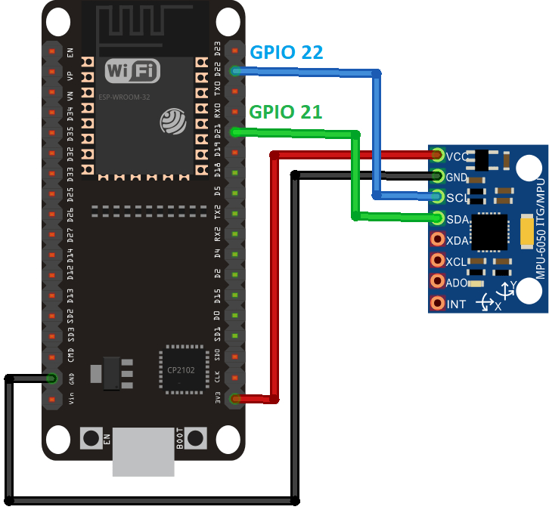
SCHEMATICS
HARDWARE CONNECTIONS
ESP32 -> MPU 6050
D22 -> SCL
D21 -> SDA
3V3 -> VCC
GND -> GND

Slide 8
PROJECT CONTRIBUTION

Slide 9
PROJECT PARTITION
The project has been divided into the 4 parts. They are:
Testing hardware components
Data Acquisition
Creating ML model
Deployment of model
PART 1 and 2: Done By Rohit Ranjan (2001CS56)
PART 3 and 4: Done By Kartik Mouli (2001CS35)

Slide 10
PART 1

Slide 11
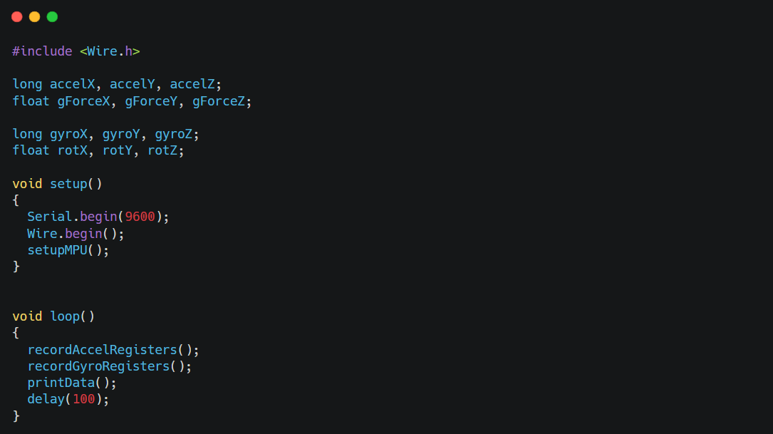
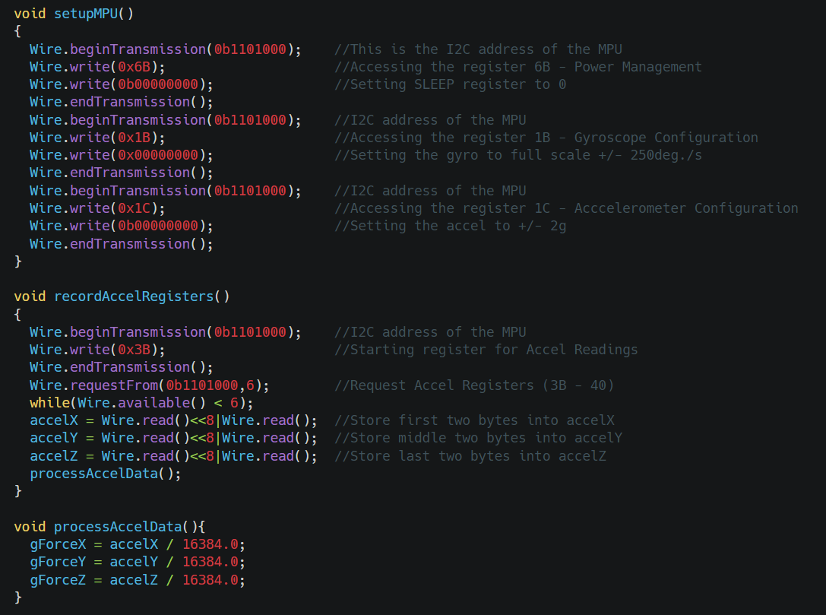
TESTING HARDWARE COMPONENTS
Code for Testing the working condition of MPU 6050 Sensor

Slide 12
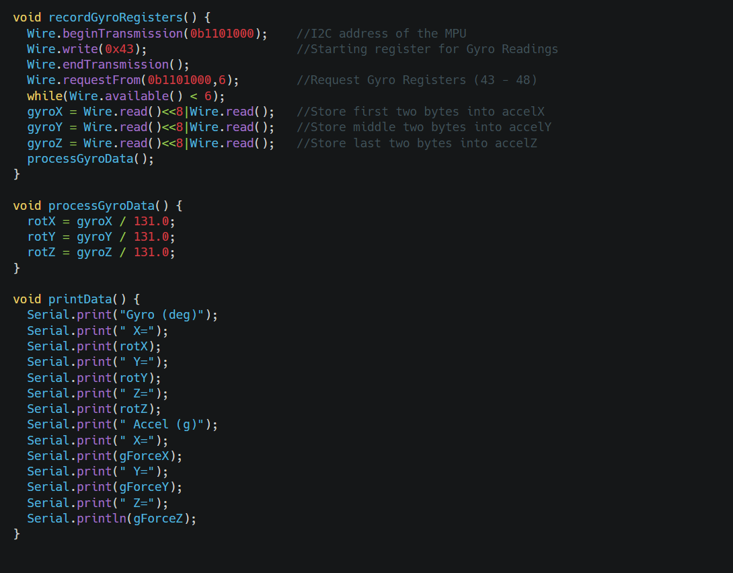
TESTING HARDWARE COMPONENTS

Slide 13
PART 2

Slide 14
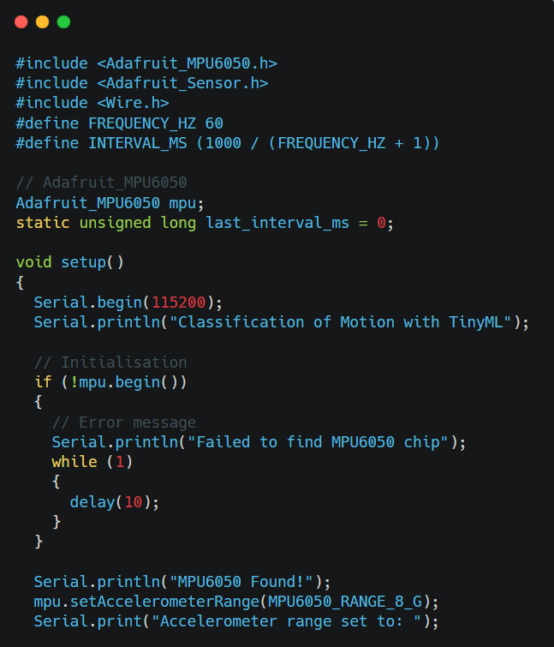
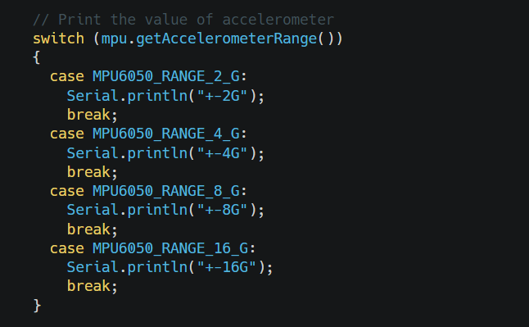
DATA ACQUISITION
Code for Data Collection

Slide 15
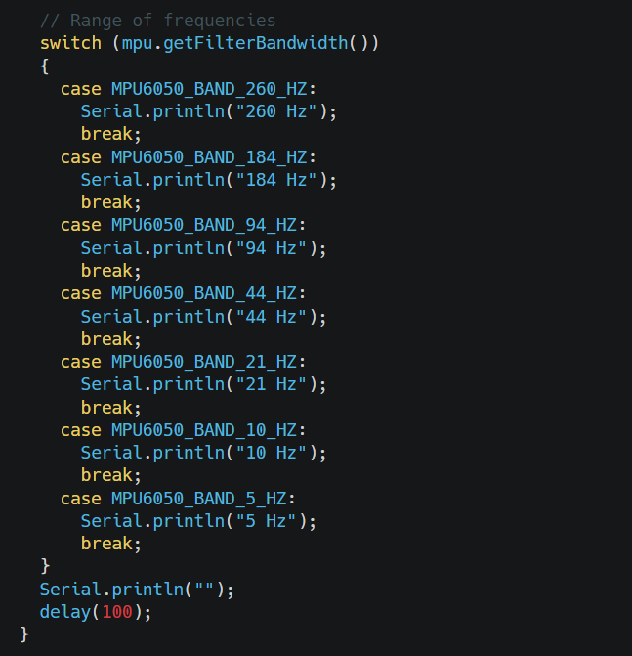
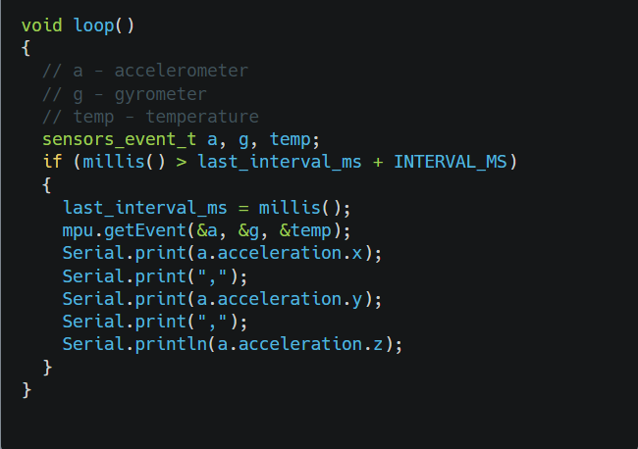
DATA ACQUISITION

Slide 16
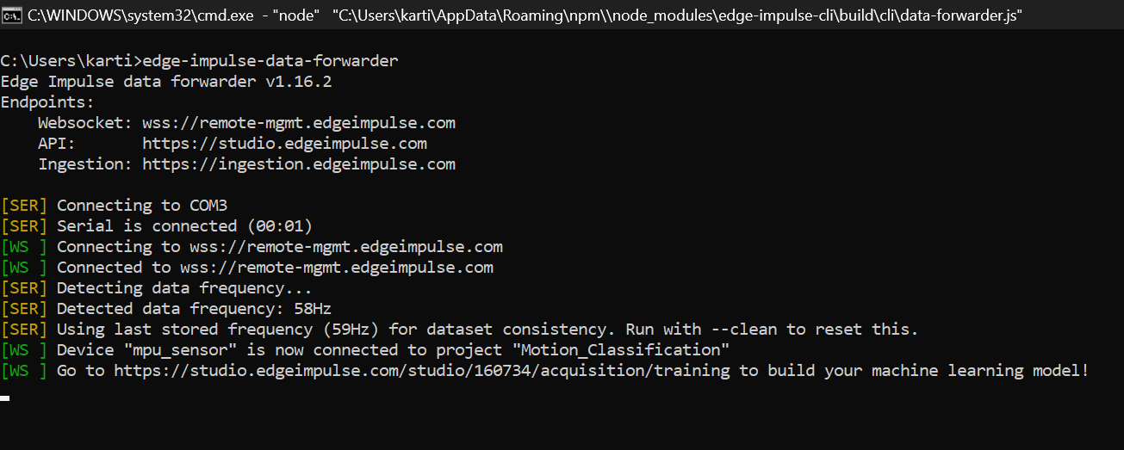
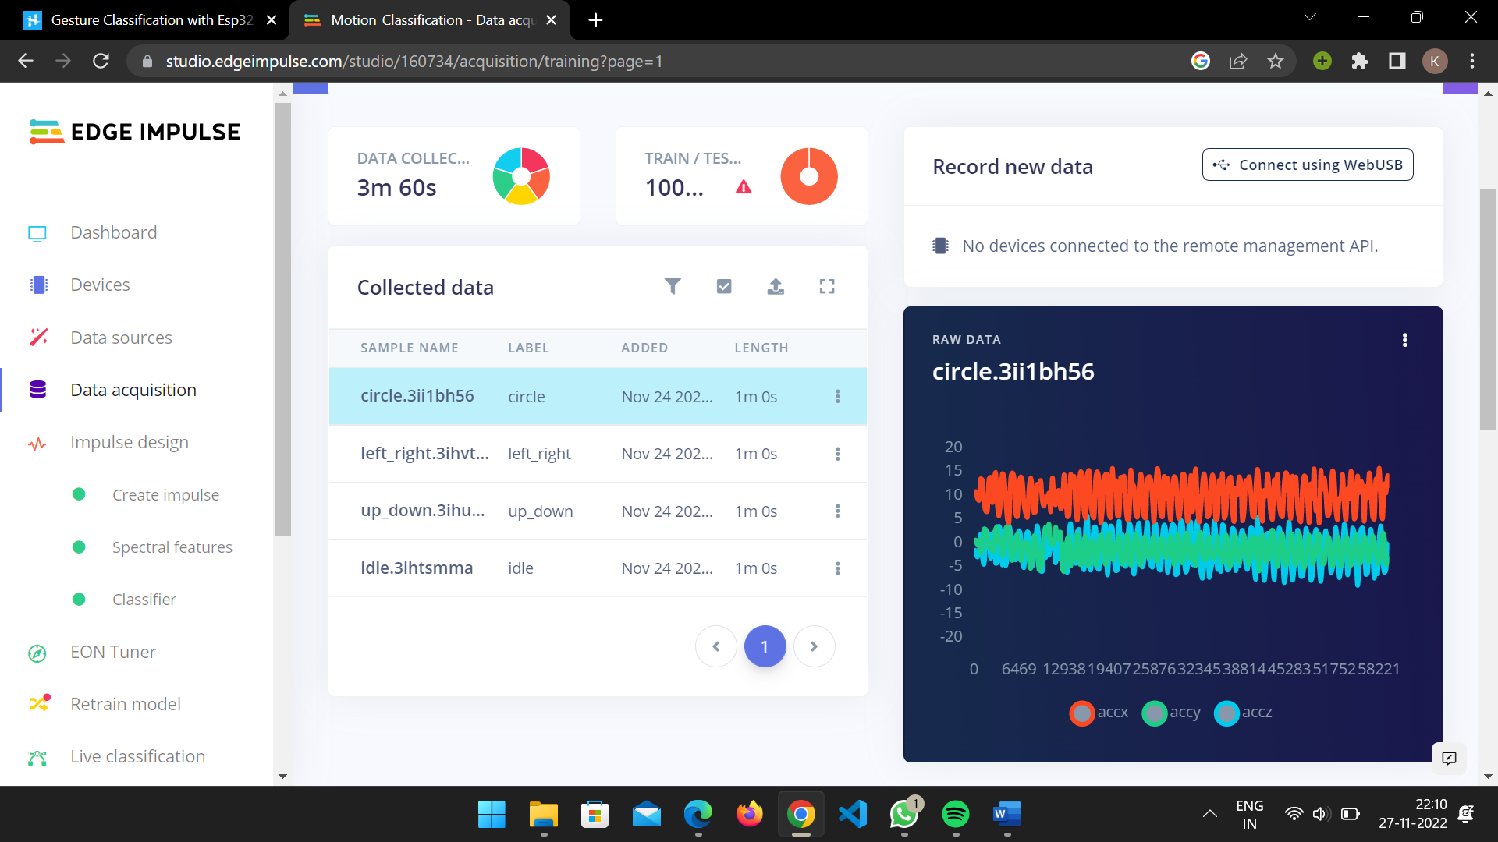
Collected data on Edge Impulse

Slide 17
PART 3

Slide 18
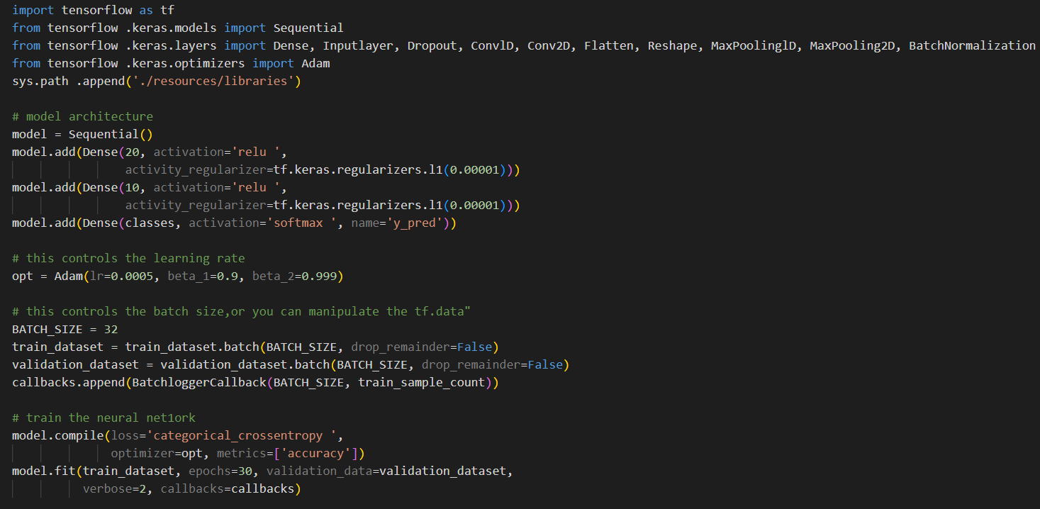
CREATING ML MODEL
Motion Classification Model

Slide 19
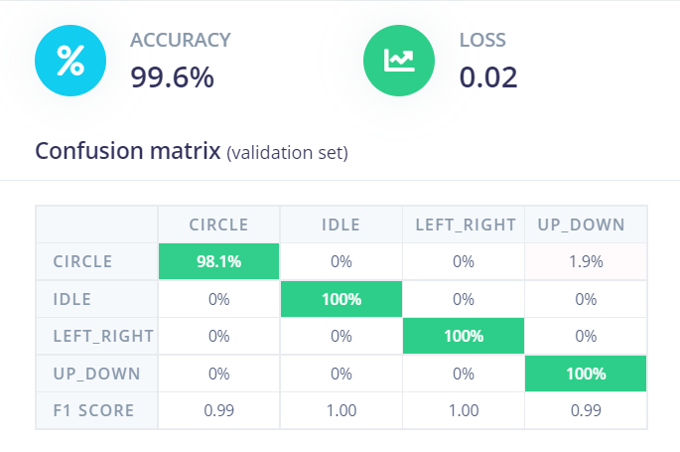
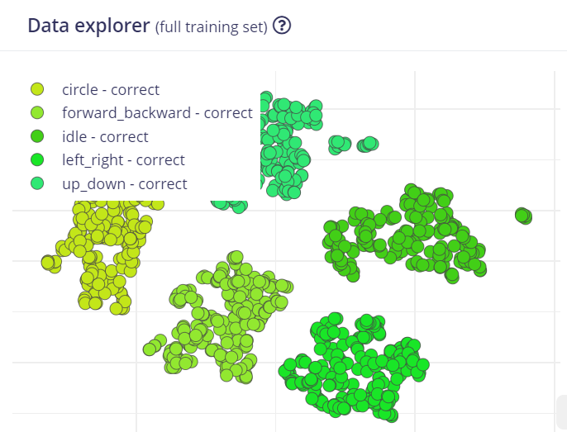
PERFORMANCE OF MODEL
Confusion Matrix

Slide 20
PART 4

Slide 21
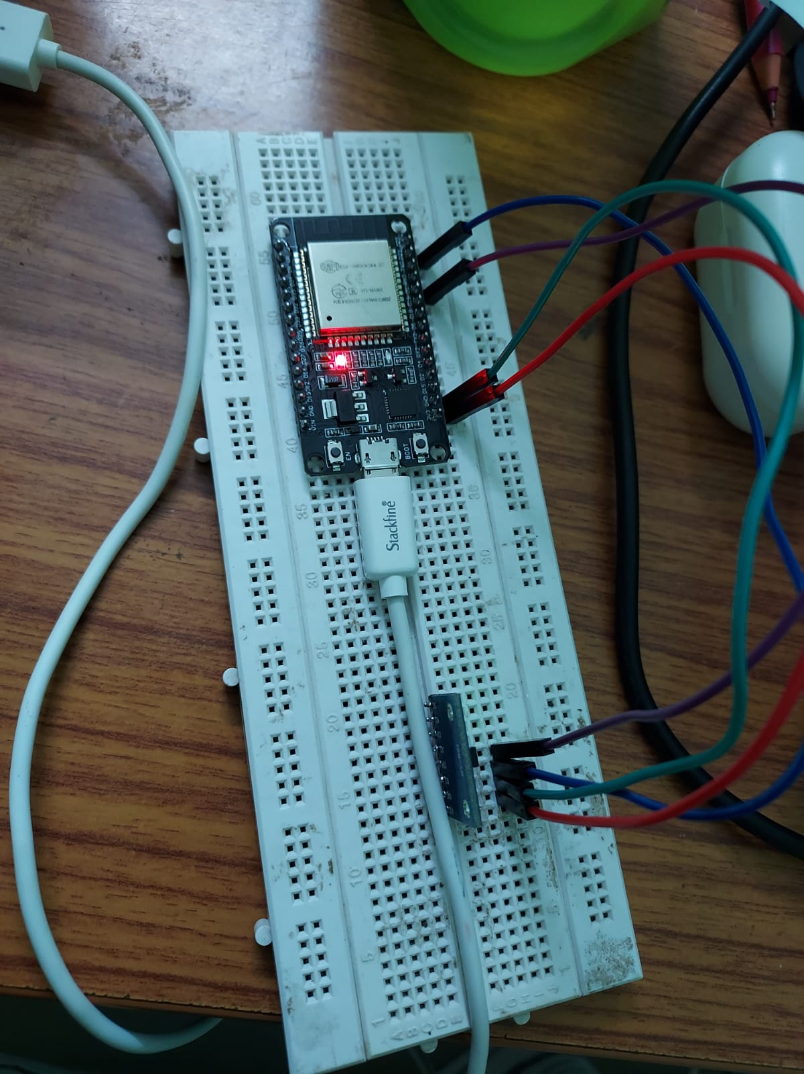
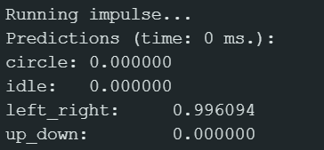
DEPLOYMENT OF MODEL
Result generated by model

Slide 22
Thank You

